Slide 1

Presented by:
Rigat David Mahanan
April, 2025

Slide 2
Introduction: The Art and Science of Music Classification
Music genres like classical and punk carry distinct identities.
Can a machine learn to distinguish Beethoven from The Ramones?
This project explores building a genre classifier using the GTZAN dataset and ML.

Slide 3
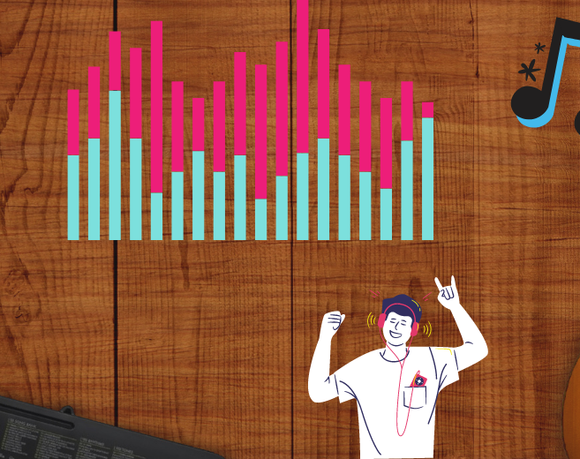
The Goal: Classifying Music Genres
Classify audio clips from the GTZAN dataset (1000 .wav files across 10 genres).
Steps:
-Extract audio features
- Visualize data
- Train ML models
- Optimize performance

Slide 4
Setting Up the Data
•GTZAN dataset organized by genre folders.
•Accessed using relative paths for portability.
•Prepared for processing and feature extraction.

Slide 5

Feature Extraction
• Extracted 35 features per file using librosa:
Tempo, MFCCs, Spectral features, Chroma, etc.
Features saved for model training and evaluation.

Slide 6
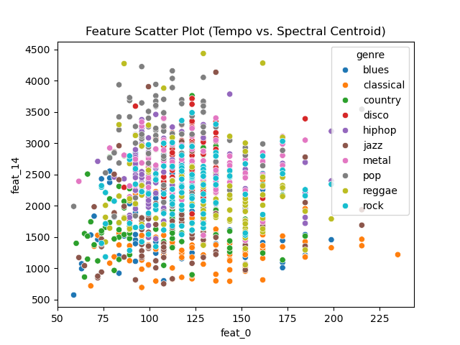
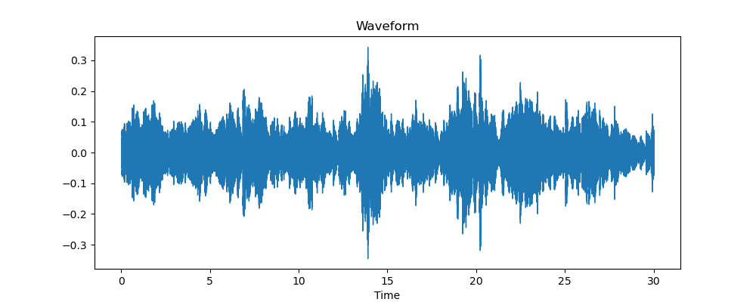
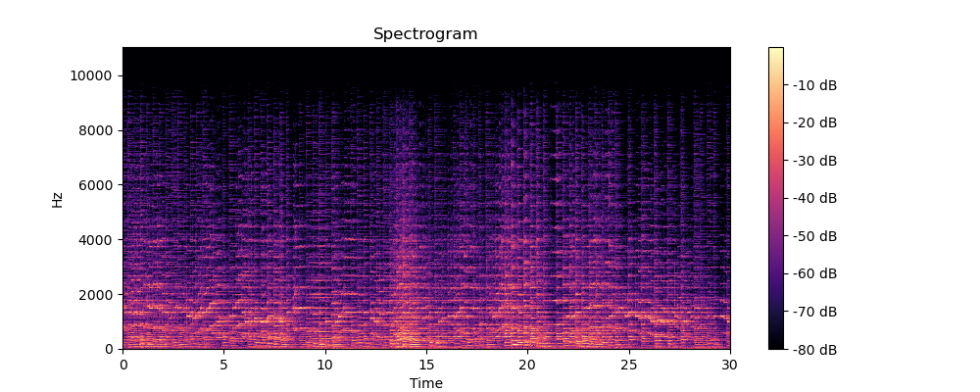
Visualizing the Data
Visualizations:
- Waveform (Amplitude)
- Spectrogram (Frequency content)
- Feature scatter plot (Tempo vs. Spectral Centroid)

Slide 7

Training Models
Models used: Logistic Regression, SVM, Random Forest, Linear Regression.
Performance boosted with:
- Expanded features
- GridSearchCV for tuning

Slide 8
Tuning Models
First try: ~50% accurate for genres.
Added 35 clues (from 15), e.g., notes, texture.
Tuned models:
SVM: C=10, gamma=0.01.
Random Forest: max_depth=10, n_estimators=100.
Linear Regression: Predicted tempo (MSE = 800.09, R² = -0.03).

Slide 9
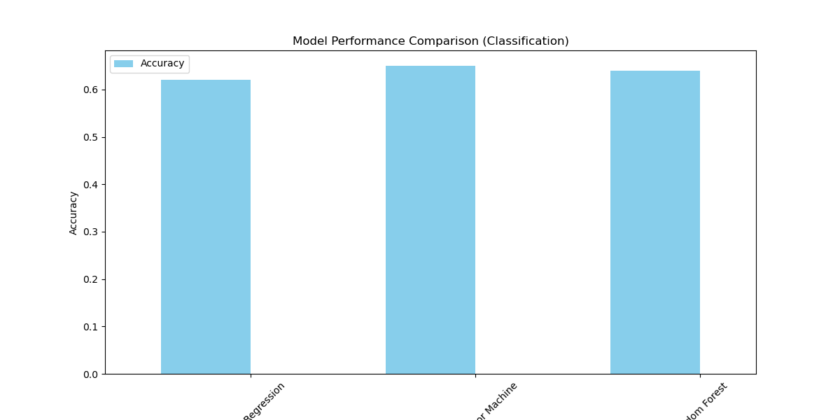
Results: A Leap Forward
Test Accuracies:
- Logistic Regression: 62%
- SVM: 65%
- Random Forest: 64%
Linear Regression used for predicting tempo

Slide 10

Risks and Opportunities
Risks: Misclassifications, computational cost, dataset limitations.
Opportunities: Improve accuracy, boost user engagement, empower musicians.

Slide 11

Challenges and Lessons Learned
Feature dimensionality issues
Need for model tuning
Dataset size/label issues
Suppressing warnings and optimizing resources was key.

Slide 12
Future Improvements
Add more features
PCA for dimensionality reduction
Deep learning for higher accuracy

Slide 13

Conclusion: Music Meets Machine Learning
Built a 35-dimensional feature set from raw audio.
Achieved up to 65% accuracy using classical ML models.
Data science bridges music and technology.

